Slide 1


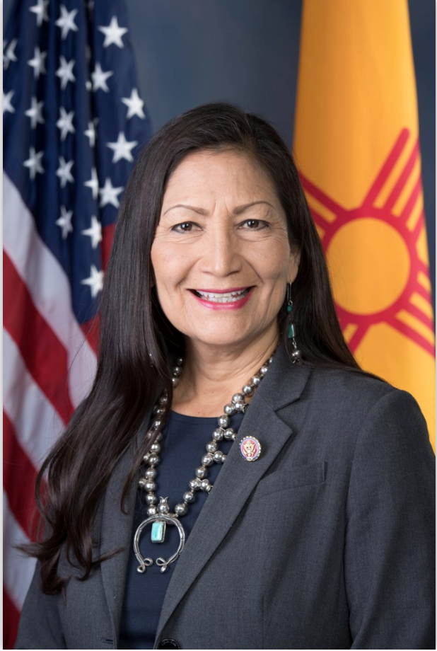
National Security and Critical
Technology Study Programs*
Career Workshop & Summer Research Poster Session
AUGUST 27 in the SUB
WORKSHOPS
Presentations by Sandia, LANL, and CIA representatives on the many career paths in national security and intelligence fields.
POSTER SESSION
4:30 PM Atrium Poster Session – over 40 posters of summer research by NM students in the National Security and Critical Technology Study Programs. Congresswoman Deb Haaland will visit with students and view posters.
Critical
Technology Study Program (CTSP) is for:
Students in any major, especially undergraduates in STEM, business and social sciences.
Interested in getting prepared for a great career in NM, nationally, or worldwide?
Learn about CTSP and how to participate in CTSP and NSSP
activities and projects.
Time | Sandia Rm: Fiesta | LANL Rm: Isleta | CIA Rm: Luminaria
1:00 | A | A | B
1:45 | A | B | A
2:30 | B | A | A
3:15 (joint) | Career preparation, planning and advice, Rm: Fiesta A&B
A – Tech and Work opportunities B – Internships and Applying Tips
Students should rotate to different sessions depending on their interests
6 PM Talk and Q&A with NM District 1 Congresswoman Deb Haaland in Atrium of UNM SUB.
*NSSP and CTSP are programs in the UNM Global and National Security Policy Institute (GNSPI).
Workshop and Poster events are open to all UNM students and faculty

